Slide 1
AI 1-Pager Template
For non-LLM* related applications, fill up slide 2-4
For LLM* related applications, fill up all slides.
*
LLMs are AI models trained on large amounts of textual data, and can power a wide range of applications in language-related tasks. This technology can help with tasks such as drafting, summarisation and brainstorming using simple prompts. Examples of LLM include ChatGPT, Google’s Bart e.t.c.

Slide 2
AI Governance Assessment for <<Gen AI Curriculum Builder App (state project number(if any) & name) >>
Last updated: dd-mm-yyyy
Ethical Concerns
(Guiding Questions) Will the use of the AI model:
erode staff users’ ability to make key professional decisions over time? No. (User will have ability to decipher output and make judgments based on expertise)
contribute to or reinforce biases held by staff users about students? No. (No decision on students/staff)
diminish student users’ choice and control over key personal decisions, e.g. decisions about education pathways? No. (User will have ability to decipher output and make judgments based on expertise)
compromise student users’ development in cognitive, social and/or moral competencies?
No. (User will have ability to decipher output and make judgments based on expertise)
Algorithm and Data for Model Development
What data will be used for the model development? Are they relevant?
Non-Assessment related ITE Curriculum Documents- Skills Standards
ITE Curriculum Advisory Committee Meeting Minutes. (CAC)
ITE Academic Advisory Committee Meeting Minutes. (AAC)
Has the use of identified datasets been approved by Data Owner?
Dataset Owner- CED
Approval will be sought from D/CED (Eric)
Which particular data field(s) is/are critical decision factor?
AWS to Advice
(Explainability) Explain how is the AI model functions and arrives at the output it has predicted. Provide a technical explanation as well as a layman explanation for the user (e.g. using counterfactual explanations).
AWS to Advice
Impact Analysis
Please conduct Impact Analysis using the following chart on Probability and/or severity of harm on individuals and organizations who are affected by the AI solution. Give your reasons for your choice and provides measures if any:
Severity of Harm | High Severity Low Probability | High Severity High Probability
 | Low Severity Low Probability | Low Severity High Probability
 | Probability of Harm
Human Involvement:
Describe your recommended level of human involvement and give reasons for your choice (delete where applicable):
Human-in-the-loop
Human-over-the-loop
Human-out-of-the-loop
Stakeholders
List down internal and external stakeholders that will be involved and/or impacted by the deployment of this AI solution:
CED – Curriculum Development Specialists, CED Managers
College - Lectures, Section Head, Course Manager
Assessment (EXM)
External – AAC Members, Industry Attachment Partners
Skill Future Singapore?
RESTRICTED/ NON-SENSITIVE

Slide 3
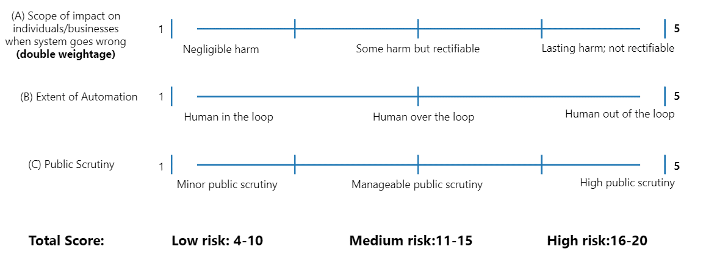
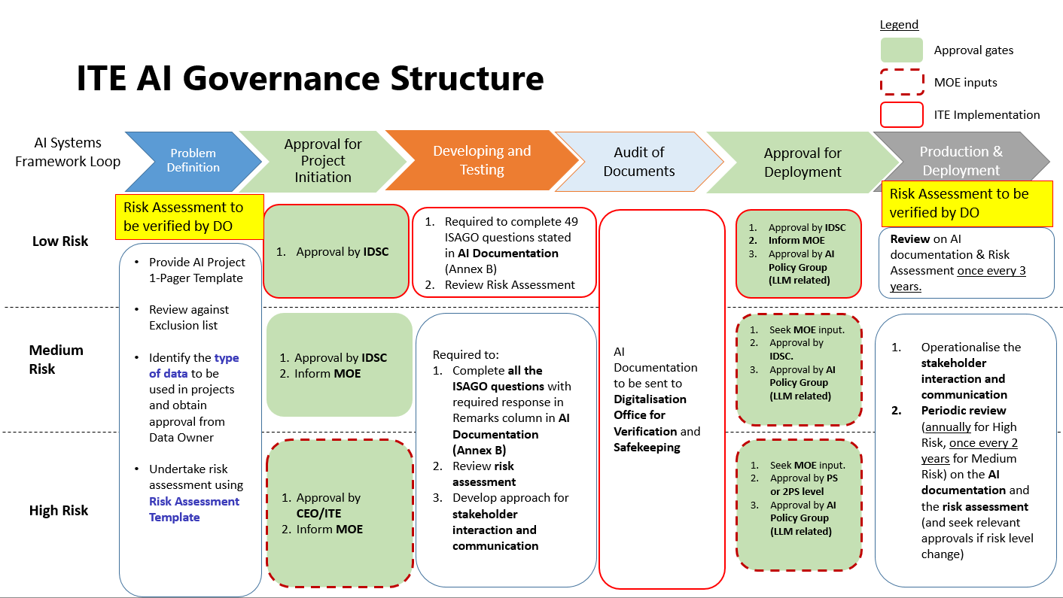
AI Risk (NAIO) - To Determine the Governance Level
Please provide your AI Risk (NAIO) Assessment:
S/N | Category | Score
A | Impact (Double Weightage) | 2
B | Extent of Automation | 1
C | Public Scrutiny | 1
 | Total | 4
 | Risk Level (Low/Medium/High) | Low
AI RISK (NAIO) Assessment Explanation
Provide your reasons and justification on the score above. If the risk level is medium and above, please provide mitigation measures and document in the Risk Register.
RESTRICTED/ NON-SENSITIVE

Slide 4
AI & System Risks & Mitigation
Please highlight type of risk or residual risk (if any) that require IDSC oversight and approval for acceptance.
ID | Type of Risk | Risk Statement | Likelihood Rating | Impact Rating | Risk Level | Mitigating Controls | Action Party | Residual Risk | Comments
RESTRICTED/ NON-SENSITIVE

Slide 5
LLM Applications Risk Level Assessments
 | Applications to be used primarily as a productivity aid Applications that are meant to be used primarily as productivity tools do not have, as their core function, the provision of factually accurate output. Examples: Summarisation, drafting, rewriting, classification, recommendation | Applications where information retrieval or fact finding is a core value proposition Information retrieval applications are those whose core value proposition is to answer factual questions. Even where express warnings are provided, users may nevertheless rely on the application’s responses for factual accuracy. Higher risk of inaccurate, or skewed outputs, if questions were asked and responses were relied on for factual accuracy. Examples: Chatbots, document query engines
Public facing Impacts reputation of Government Public-facing applications are those where members of the public can interact directly with the applications, e.g., by entering prompts. Higher risks (e.g., reputational) to the Government if inaccurate or inappropriate outputs are provided to the public. Greater risk of public users deliberately coaxing bad or skewed responses from the system. Examples: Public chatbots, recommender systems | Med risk e.g. recommender engine Mitigating measure(s) Adversarial testing Education | High risk e.g. public chatbots Mitigating measure(s) Minimise hallucination Adversarial testing Education
Internal facing Risks contained within Government; public officers also expected to exercise due diligence. Internal-facing applications are those which are not accessible by the public. Less risky because output is not being provided directly to the public. Risks can also be mitigated by levels of checks within Government. Government has more avenues to educate public officers to exercise due diligence and care when using LLM applications, and the ability to take corrective or disciplinary action, if necessary, in the event of misuse. Examples: Internal chatbots, summarisation tools | Low risk e.g. drafting, summarization, classification Mitigating measure(s) Education | Med risk e.g. document Q&A engines, internal chatbots Mitigating measure(s) Minimise hallucination Education
Application facing type:
< Public / Internal >
Remark: Internal Facing.
Output from this project will not be released to public before scrutiny and evaluation.
All documents are meant for internal use and reference.
Risk Matrix Guide:
Application Purpose:
< Productivity Aid / Information Retrieval >
Remark: Productivity
Application meant for summarization of minutes, identify commonalities in skills and suggest new course structure.
Please provide your LLM Risk Assessment:
Low / Medium / High
RESTRICTED/ NON-SENSITIVE

Slide 6
LLM Applications Risk Mitigating Measures
Mitigating Measures (Accuracy & Accountability) :
Proposed Mitigating Measures as per risk level:
Education
Education:
UX cue to warn and inform users of the use of LLMs
UX cues to warn that application do not replace IMS Procedure in Development/ Review of Course/ Module/ Electives. Approvals of outputs are to remain in force as per IMS.
User to evaluate output as a working group committee in terms of relevance, accuracy and suitable for level of program (ie. CoC, Elective, Core Modules, Type A/ Type B)
Minimise Hallucinations:
Adversarial Testing:
UX cues to educate and inform users:
That the agency is piloting the use of LLMs
Of the results that are AI-generated (e.g., through labelling or watermarks)
To always double-check output.
For productivity tools, caveats should be included to indicate that the application should not be relied upon for factual accuracy.
Minimise Hallucinations
Steps that may be taken to minimise hallucinations include:
Limiting output to information drawn from a reliable knowledge base
Enabling the user to verify the output with relevant citations.
Setting the model temperature to 0, as this will also reduce the likelihood of hallucinations.
Conducting accuracy/robustness tests to ensure that the AI performs satisfactorily for a range of commonly asked questions.
Adversarial Testing
Conduct tests to ensure that the AI performs satisfactorily against prompts designed to elicit inappropriate responses.
Agencies may wish to have a comprehensive plan to systematically test and measure the AI’s performance (e.g., against a testing question bank, and with a record of outputs).
Agencies may wish to set up a red-teaming regime for this (e.g., a dedicated red-team, or a “bug bounty” programme).
Agencies may wish to rate-limit queries to deter users from “brute force” approaches to fooling the application.
^{[1]} Temperature is a variable (from 0 to 1) that determines the amount of randomness in the LLM’s responses. Setting temperature to 0 makes the model provide predictable and less creative responses, whereas setting it to 1 provides more “creative” responses.

Slide 7
LLM Applications Security Risk Assessments
Standards (Security) :
Data Security
By default, Government LLM applications must only ingest data that are suitable for public consumption (i.e., up to OFFICIAL (CLOSED) / NON-SENSITIVE).
Agencies developing Government LLM applications are to seek approval from the AI Policy Group (SNDGG) for applications that will ingest data above OFFICIAL (CLOSED) / NON-SENSITIVE.
Approval will take into account whether: (a) data transmission will be encrypted end-to-end, and (b) data will not be logged within overseas servers.
Security Risk Assessments:
Data Security:
System Classification : Official Open / Official Closed / Restricted
Sensitivity Classification : Sensitive High / Sensitive Normal / Non-sensitive

